Slide 1
GROCERY WEBSITE KIRTHIGA R MAHALAKSHMI A MAHALAKSHMI V JASMINE PRESILLA J

Slide 2
agenda
INTRODUCTION 3
UNDERSTANDING CUSTOMER NEEDS 4
KEY FEATURES 5
TECHOLOGY STACK 6
CONCLUSION 10

Slide 3
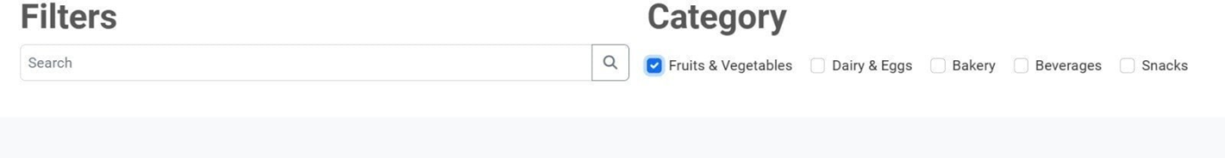
Introduction To Customer Experiences
Our grocery app offers a seamless
shopping experiences
Allowing users to easily Browse,Select,and purchase fresh products
Also it's provides a fast delivery with secure payment option

Slide 4
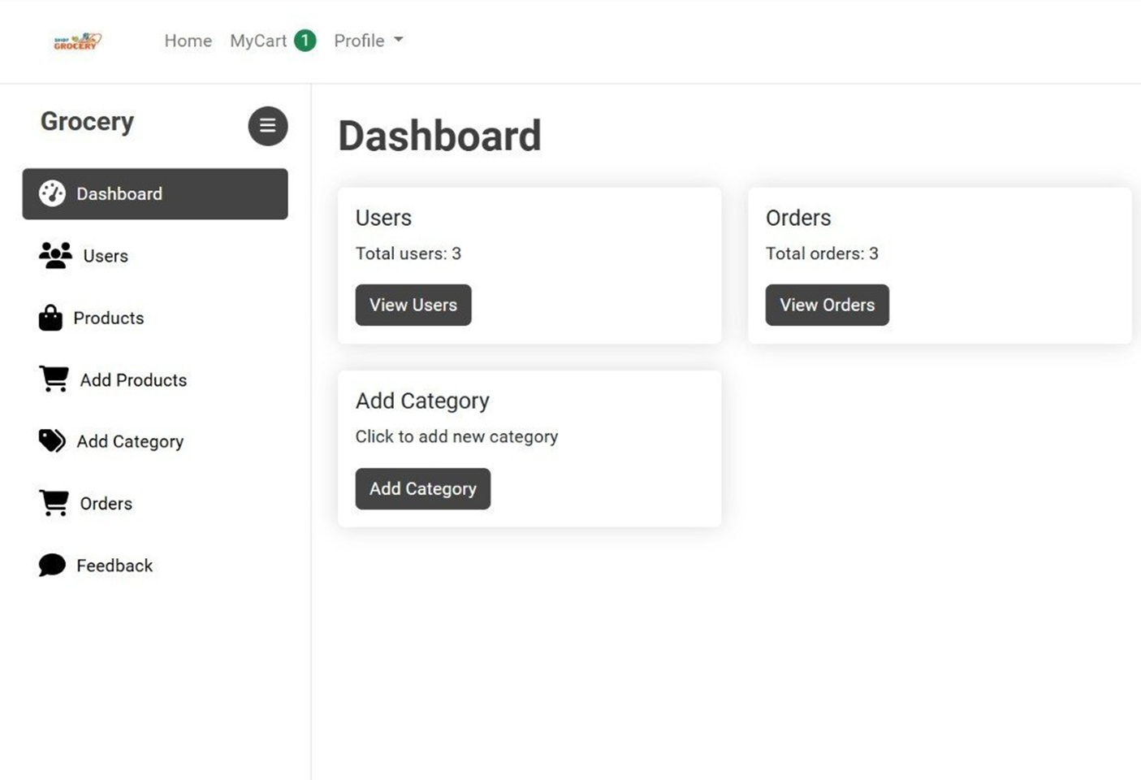
Understanding Customer needs
USER CONVENIENCE : provides an intuitive, easy-to-navigate interfaces
AFFORDABLE PRICING : Offers
competitive prices, discounts and
rewards for regular users
FRIENDLY DASHBOARD : Offers a friendly and clean dashboard for better searching options for customers
4

Slide 5
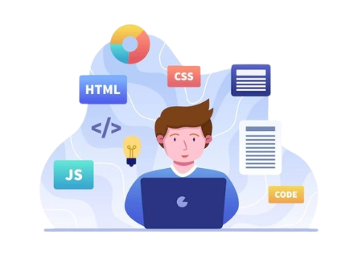
Key Features
Easy products search
Personalized recommendations
Secure payment options
Fast delivery
Eco-friendly packing
Loyal rewards
customer support

Slide 6
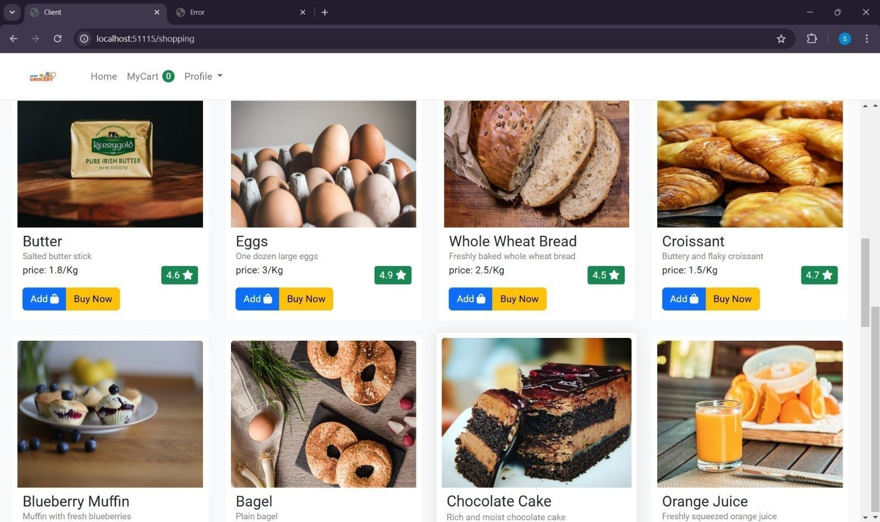
Technology Stack
FRONEND
BACKEND
INTEGRATION

Slide 7
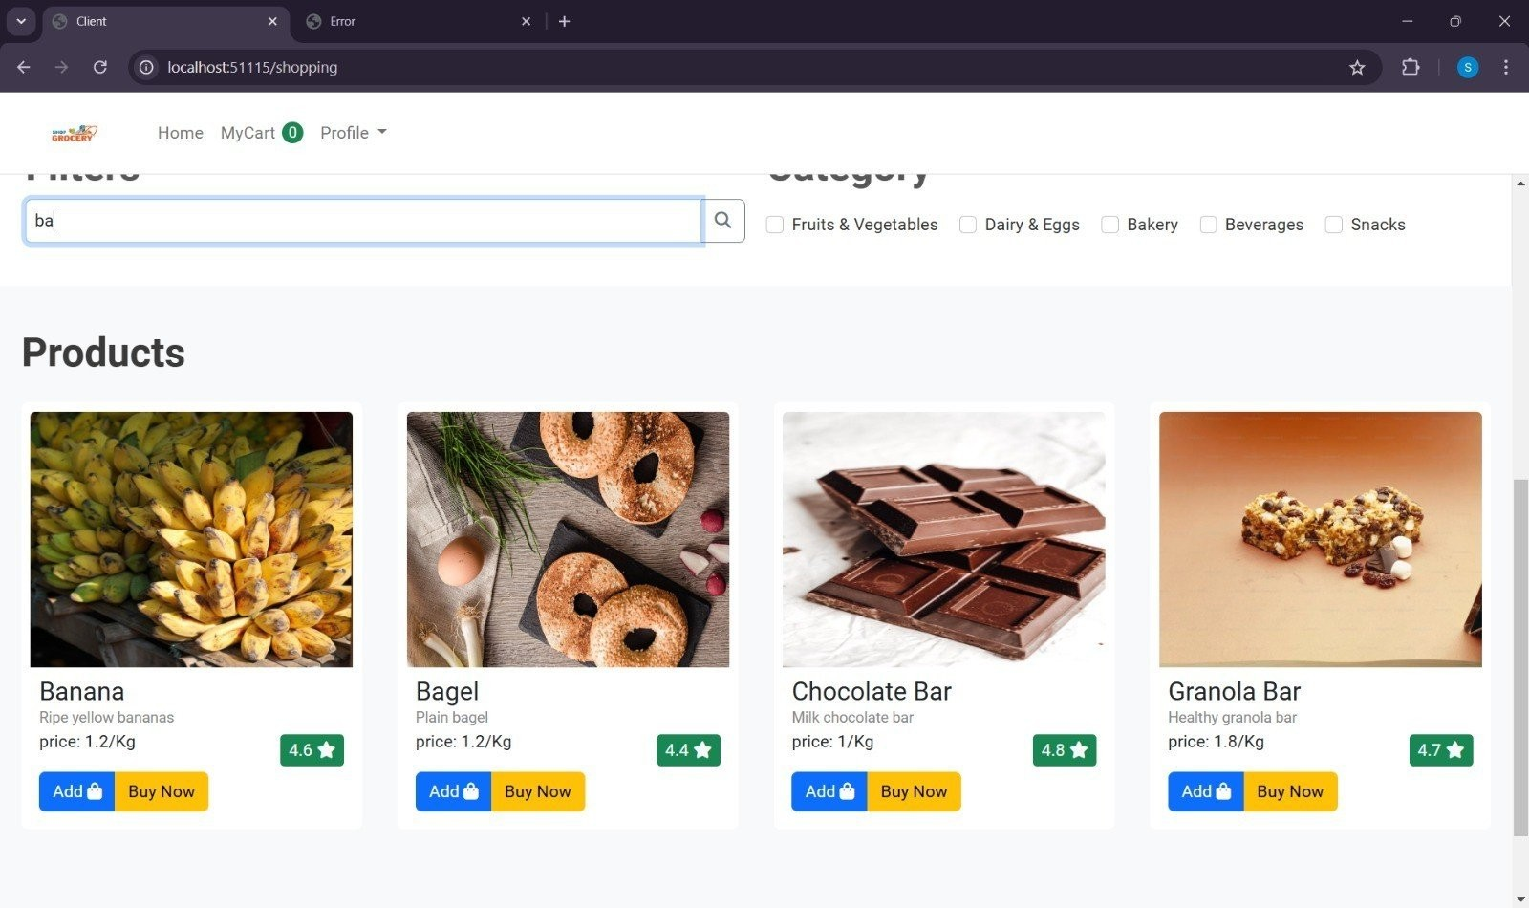
Streamlined Search Option
Our application simpliﬁes the grocery shopping process through features like easy navigation, quick search options, and a streamlined checkout experience. By reducing friction in the shopping journey, we enhance consumer satisfaction and encourage repeat visits.
7

Slide 8
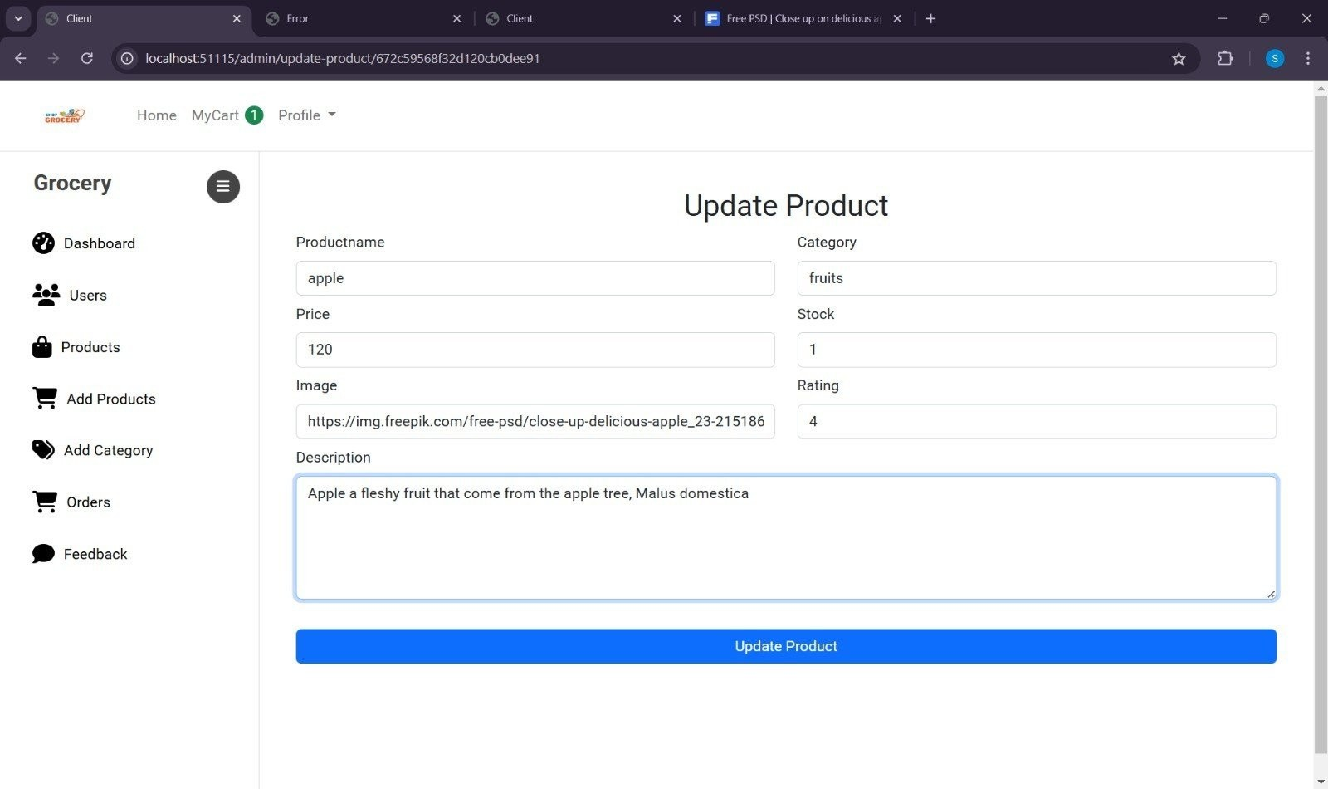
Real-Time Update Product
With our UPDATE PRODUCT system, consumers are always aware of product availability. This transparency helps in making informed purchasing decisions and reduces frustration caused by out-of-stock items, ultimately improving the shopping experience.

Slide 9
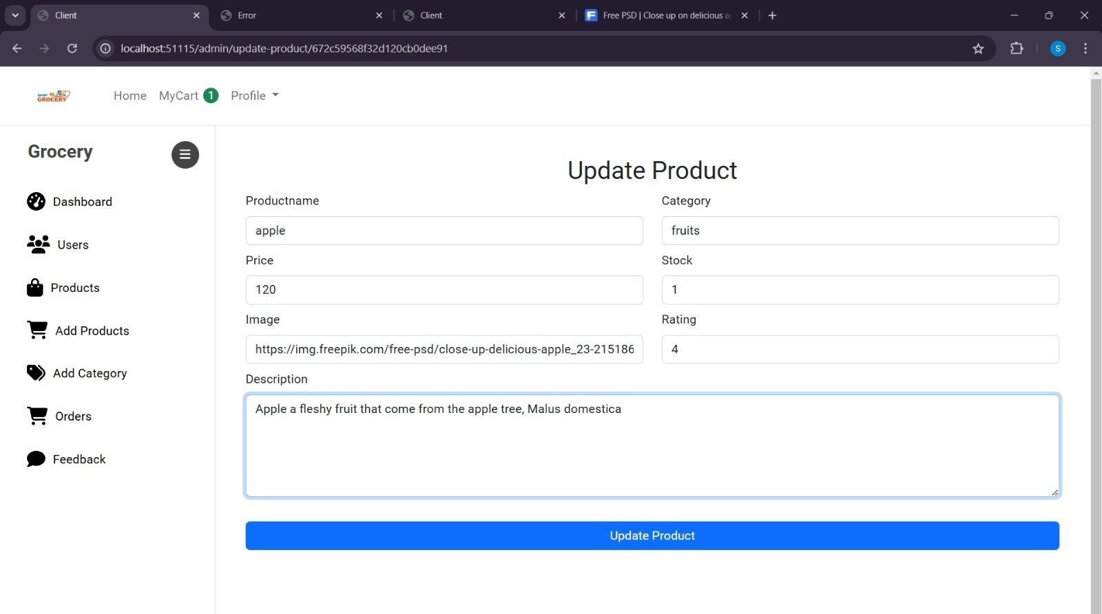
Efficient Ordering Interface
Intuitive navigation
Realtime updates
Seamless checkout
Multiple payment option

Slide 10
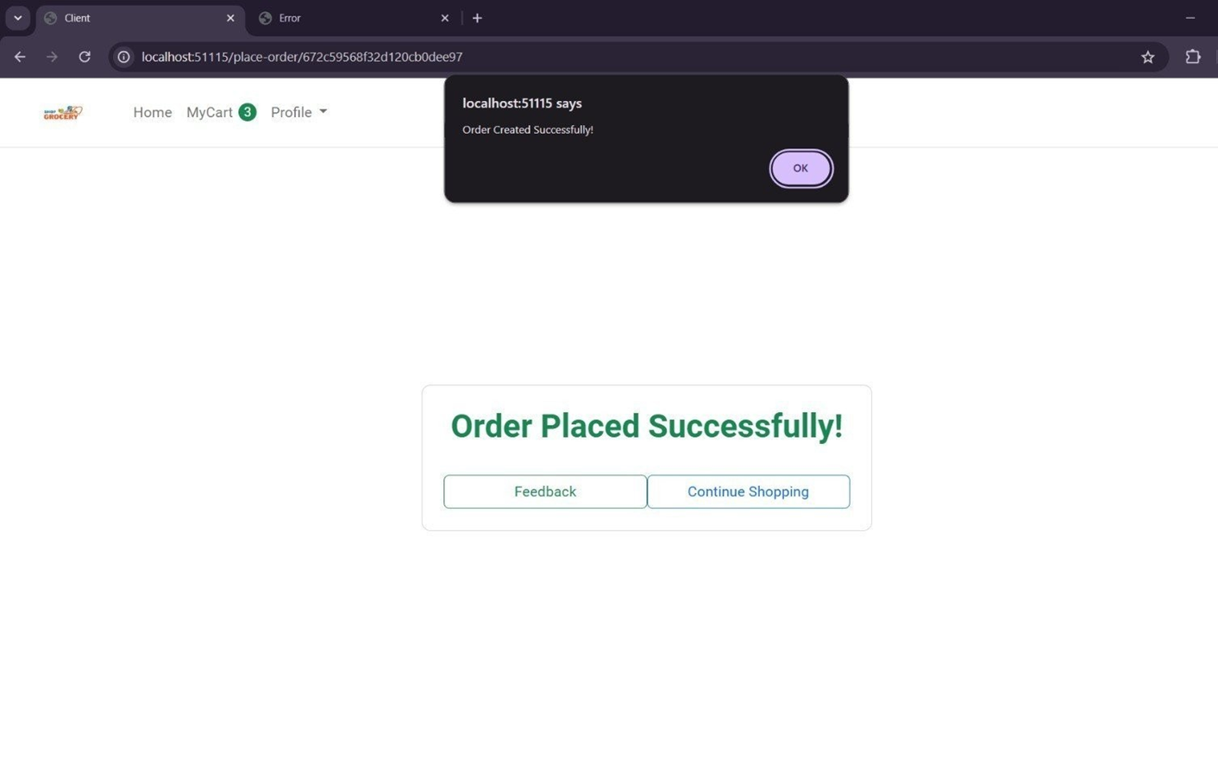
Conclusion
In conclusion, enhancing consumer experience in grocery shopping is a multifaceted challenge that our web application addresses effectively. By focusing on personalization, convenience, and technology, we can create a shopping experience that not only meets but exceeds consumer expectations.

Slide 11
thank you

